Slide 1

[Samsung PRISM Elite] | Monthly Connect | MSRIT |
MSRIT2Elite: Occupancy Flow Prediction for Automotive Vision
Team
MSRIT Professors:
Students:
Dr. S. Rajarajeswari Associate Professor in Computer Science Department raji@msrit.edu | Dr. S. Sethu Selvi Professor in the Department of Electronics and Communication selvi@msrit.edu
 | Name | Email | Sem | Department
1. | Harsha.H.S | hsharsha@msrit.edu | M.Tech., Sem 1 | CSE
2. | Sanjana C | 1ms21ai052@msrit,edu | 6th | AI&DS
3. | Siddarth Bhetariya | 1ms21ai061@msrit,edu | 6th | AI&DS
4. | Tejas Hegde | 1ms20cs129@msrit.edu | 8th | CSE

Slide 2

Occupancy Flow Prediction for Automotive Vision
Problem Statement
Develop a DNN for predicting BEV occupancy and flow of vehicles.
Develop a DNN for predicting BEV occupancy and flow of vehicles.
Address motion forecasting for autonomous driving.
Use occupancy flow fields for spatial-temporal occupancy and motion.
Tackle computational and scalability challenges in multi-agent prediction.
Aim for predictive accuracy and efficiency in forecasting future BEV conditions.
Implement a transformer-based network architecture.
Ground the project in recent research on occupancy flow prediction.
Identify SOTA approaches, datasets, and evaluation KPIs.
Document codebase and methodologies, ensuring comprehensive benchmarking.
Expectations
Development of a DNN network for predicting future occupancy flow fields in BEV projection.
Achievement of a transformer-based solution with enhanced predictive accuracy and computational efficiency.
Comprehensive documentation of all research, development, and evaluation activities.
Training/ Pre-requisites
Understanding of camera calibration, BEV projection, and multi-agent motion forecasting.
Familiarity with current SOTA approaches in occupancy flow field prediction.
Proficiency in deep learning, particularly in designing and training DNN and transformer networks.
Mastery of deep learning concepts and frameworks (e.g., TensorFlow or PyTorch).
Proficiency in handling and processing large-scale, multi-dimensional datasets.
Student Learning
Gaining expertise in advanced motion forecasting techniques for autonomous driving.
Developing skills in handling complex datasets and training deep learning models.
Enhancing abilities in scientific documentation and presentation of R&D work.
Learn to develop and refine deep neural networks for predictive analysis in autonomous driving scenarios.
Gain specialized knowledge in representing and forecasting dynamic environments using occupancy flow fields.
Acquire hands-on experience with transformer-based architectures, exploring their application beyond natural language processing.
Enhance skills in optimizing models for performance and computational efficiency.
Additional Documentation :
Multi-modal Hierarchical Transformer for Occupancy Flow Field Prediction in Autonomous Driving- https://github.com/georgeliu233/STrajNet
Waymo open dataset challenge 2022 occupancy flow
https://waymo.com/open/challenges/terms/?continue=%2Fopen%2Fchallenges%2F2024%2Foccupancy-flow-prediction%2F
Kick Off
Start with in-depth problem analysis and state-of-the-art review.
Milestone 1
Design and document a new, efficient network architecture; list current best practices and datasets.
Milestone 2
Train the proposed model, fine-tune parameters, and begin performance evaluations.
Closure
Complete model and process optimizations, and finalize all project documentation with benchmark results.
Notes:
-

Slide 3
Work-let Name: Occupancy Flow Prediction for Automotive Vision
Worklet Details
1. Worklet ID: MSRIT 2 ELITE
2. College Name: Ramaiah Institute of Technology
Planned Vs Actual KPIs achieved till now
Risks Identified and Mitigation Steps
On-Schedule Architectural Proposal: Achieved the milestone of proposing a novel network architecture integrating STrajNet with GRU right on the planned timeline, demonstrating adherence to the project schedule.
Ahead of Schedule Model Implementation: Commenced the implementation of the newly designed architecture into the existing STrajNet model ahead of the planned Milestone 2, indicating accelerated progress.
Comprehensive Methodology Review Completed: Met the planned comprehensive review of methodologies, ensuring a robust foundation for the project's innovative approach.
Early Start on Model Training: Initiated model training and optimization sooner than anticipated, setting the stage for advanced performance evaluation and optimization efforts.
Efficient Project Progression: The project is effectively balancing adherence to planned milestones with proactive advancements, suggesting a strategic approach to achieving project goals ahead of deadlines.
The integration of GRU into STrajNet may present unforeseen technical challenges.
Mitigation : Conduct incremental integration testing and have a rollback plan ready. Leverage expertise from cross-functional teams to address complex integration issues.
The enhanced model might not achieve the anticipated improvement in predictive accuracy or computational efficiency.
Mitigation : Establish early and continuous performance benchmarking against predefined KPIs. Be prepared to iterate on model architecture based on empirical evidence.
Heavy reliance on particular frameworks or libraries could limit the project's flexibility and adaptability.
Mitigation : Design the system with modularity in mind, allowing for easy substitution of components. Stay informed about developments in the field to avoid becoming overly dependent on obsolete technologies.
Limited computational resources might hinder model training and experimentation.
Mitigation : Utilize cloud computing resources to supplement local computational capabilities. Prioritize efficient model architectures to minimize resource demands.
Next Steps
Test the Combined Model : Complete merging the GRU with the STrajNet model and start testing to make sure everything works as expected.
Check How Well the Model Performs : Begin measuring how well the new model predicts compared to what was expected, focusing on accuracy and speed.
Make the Model Better : After seeing how the model performs, find ways to improve it, such as adjusting settings or using different data handling techniques to prevent it from making the same predictions too often.
Get Ready for Final Review : Start getting everything ready to show how well the project met its goals, ensuring all the necessary data and tools are prepared for a thorough evaluation.
Key Achievements/ Outcome till now
Analyzed multiple approaches for temporal predictions. Evaluated strengths and weaknesses. Selection of StrajNet
Identified StrajNet as the most effective method. Superior in efficiency and accuracy. Implementation and Debugging
Successfully implemented StrajNet in our project. Identified and resolved errors during integration. Architecture Design
Developed a comprehensive architecture diagram. Utilizes GRU (Gated Recurrent Units) for enhanced temporal predictions. Key Outcomes
Achieved high accuracy in temporal predictions. Streamlined the prediction process, optimizing performance.
Date: 16-04-2024

Slide 4
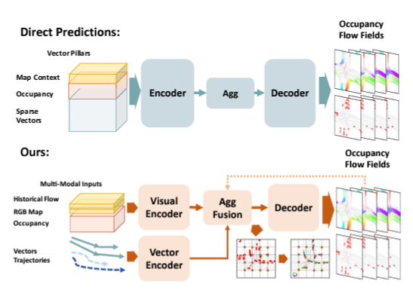

Slide 5
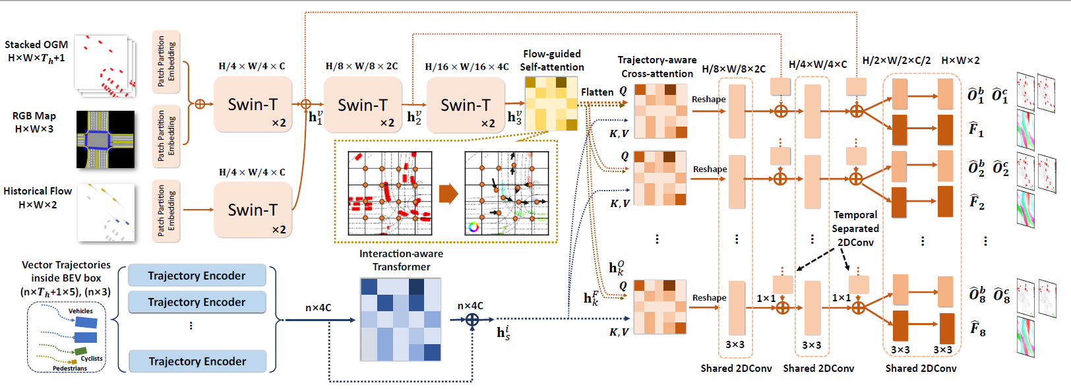
Proposed Approach / Solution
Architecture Diagram :

Slide 6
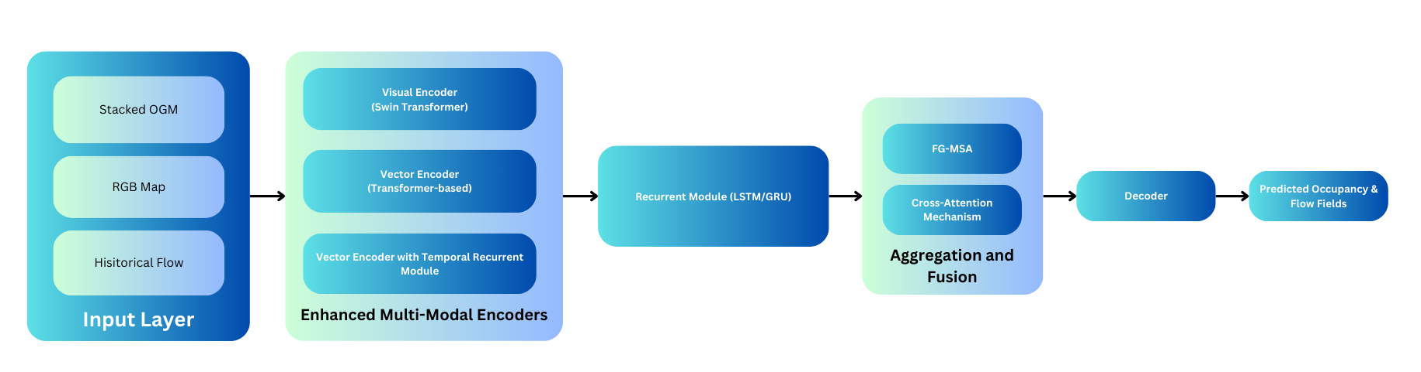

Slide 7
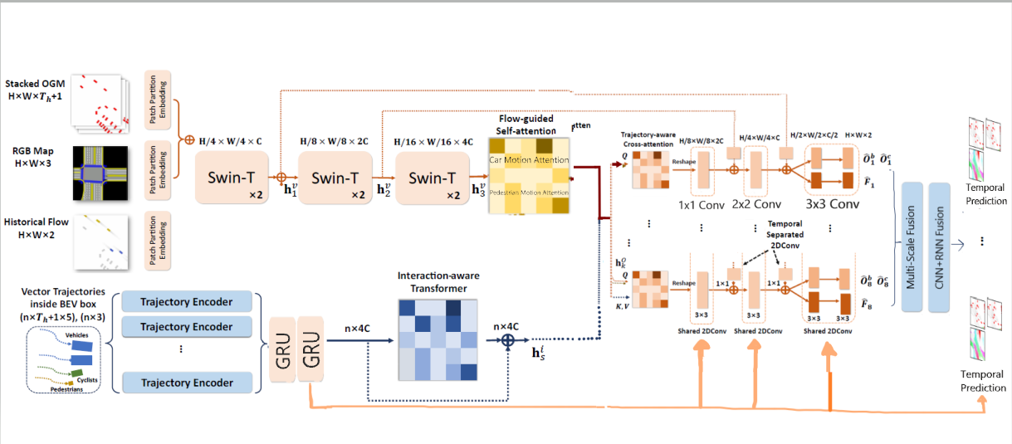
Proposed Architecture

Slide 8
Dataset(s) Analysis / Description
Dataset Capture / Preparation / Generation :
The Waymo Open Dataset for motion contains high-quality, multimodal sensor data collected from the Waymo self-driving fleet, which is useful for a variety of tasks in autonomous driving.
For the Occupancy Flow Challenge, the dataset includes scenarios that contain tracks of agents observed over a period (e.g., 1 second), along with corresponding map data.
The dataset is likely composed of real-world driving scenarios captured by Waymo's autonomous vehicles equipped with a range of sensors, including LiDAR, radar, and cameras.
These sensors provide detailed environmental data that Waymo processes into occupancy grids and agent tracks, which are further used for motion forecasting tasks.
Raw sensor data from the vehicles are processed and structured into a machine-learnable format.
Data is partitioned into distinct sets for training, validation, and testing, facilitating the development cycle of machine learning models.
Dataset Understanding / Analysis :
A thorough examination of the data involves understanding the distribution of various agent types, the variety of traffic scenarios included, and the quality of the tracks and occupancy grids.
Analysis should also account for the presence of edge cases, data balance (such as day/night, different weather conditions), and the temporal consistency of the agent tracks and flow fields.
Understanding of the dataset also implies recognizing any potential biases, the frequency of occlusions, and the coverage of various driving conditions.
It’s crucial to examine how well the dataset represents real-world driving scenarios, as this will affect the generalizability of the trained model.

Slide 9
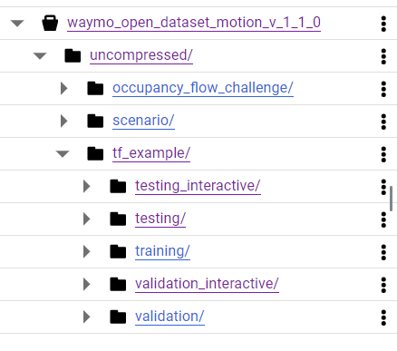
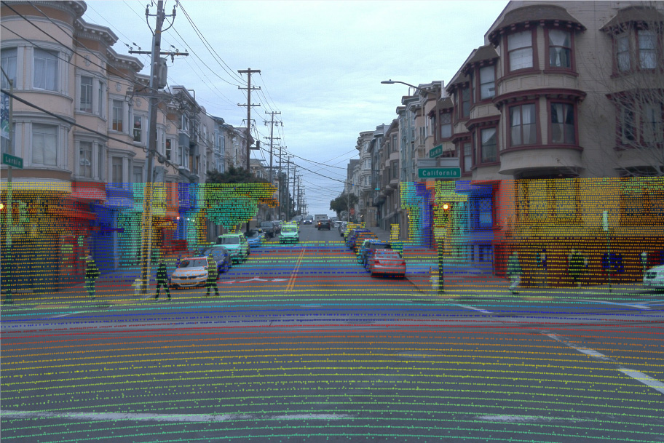

Slide 10
Dataset(s) Analysis / Description
Dataset Pre-Processing / Related Challenges and Possible Solution :
Storing and processing a 1.4 TB dataset requires significant disk space and memory, which might exceed the capacity of standard workstations. Solution: Employ databases or data formats optimized for large datasets, like HDF5 or Parquet, which enable efficient reading of chunks of data into memory.
Loading such a large dataset into memory for training can be very time-consuming, which may slow down the iterative process of model development. Solution: Implement data generators or use TensorFlow’s tf.data API to load and preprocess data on-the-fly in batches during training, which avoids loading the entire dataset into memory at once.
Ensuring quick and efficient access to data during training is crucial, especially if using distributed computing resources or cloud platforms. Solution: If using cloud platforms, consider storing the data on blob storage and using services that allow direct data streaming into the training environment.
Pre-processing steps such as normalization, augmentation, or conversion to occupancy flow fields must be optimized to handle the large volume of data without introducing excessive delays. Solution: Optimize pre-processing code to be as efficient as possible, using vectorized operations and avoiding loops where possible. Consider preprocessing the data in advance and storing pre-processed versions if storage allows for it.

Slide 11
Experimental Results / Simulations / Observations
Major Observations / Conclusions & Challenges :
Data Complexity:
The dataset's richness, with detailed sensor data from a diverse set of scenarios, provides a robust foundation for training predictive models.
2. Predictive Model Performance:
Early tests may show that models like STrajNet, which use a combination of Swin Transformers and GRUs, can effectively capture spatial-temporal relationships in the data.
3. Transformer Effectiveness:
Transformer-based models, particularly those that can handle multi-modal inputs, are effective at occupancy flow prediction, capitalizing on their ability to model complex dependencies.
4. Need for Temporal Modeling:
Incorporating temporal information via mechanisms like GRUs is crucial for improving predictions, especially for occluded vehicles.
5. Model Generalization:
The model's ability to generalize across various driving conditions, lighting, and weather suggests that the dataset is diverse and the model has learned robust features.
6. Handling Data Volume:
Processing and learning from a 1.4 TB dataset requires significant computational resources and strategic data handling methods.
7. Model Overfitting:
Given the model's complexity, there's a risk of overfitting to the training data. Regularization and robust validation techniques are essential to ensure generalization.

Slide 12
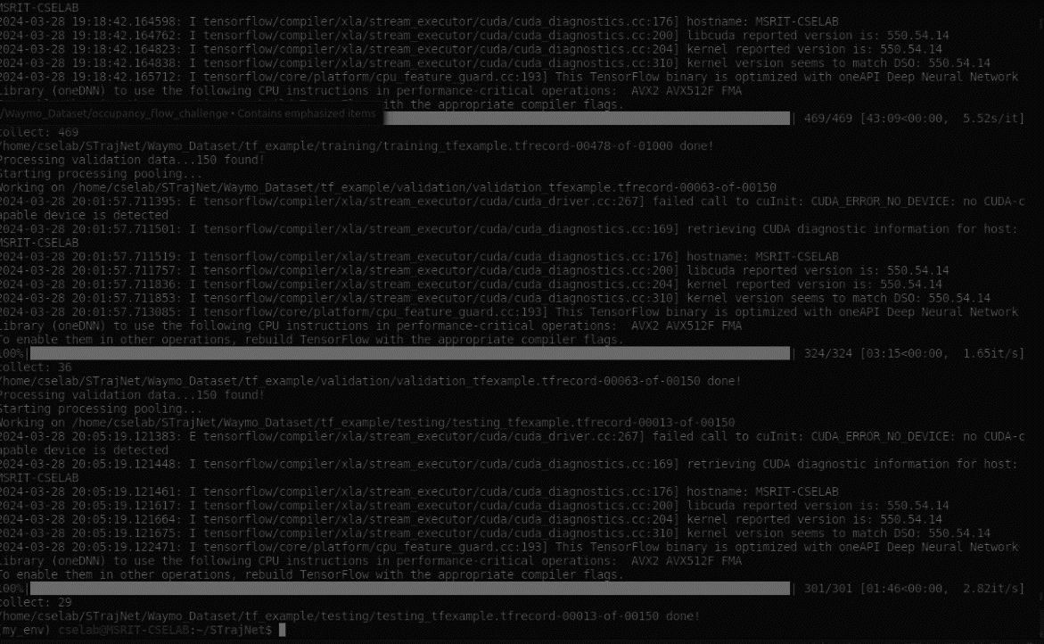
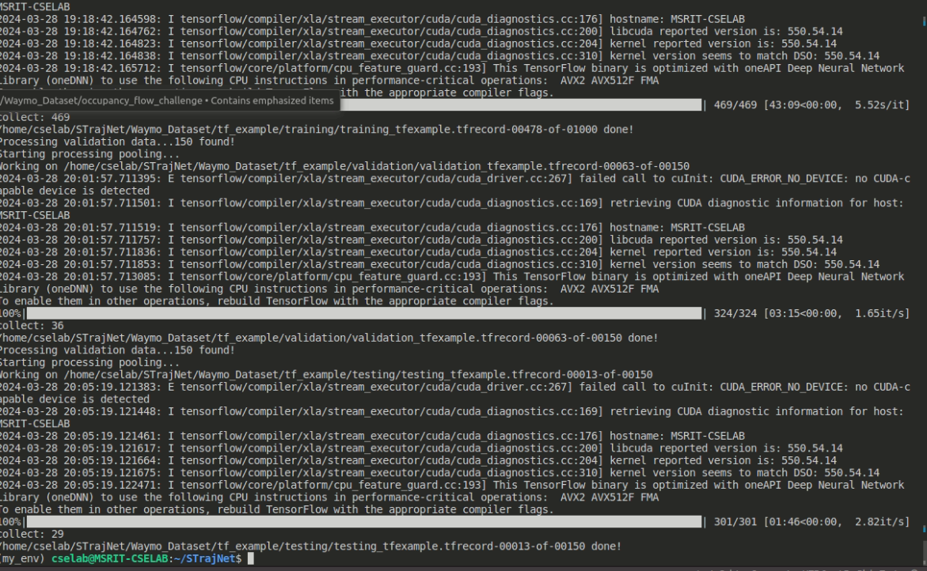

Slide 13
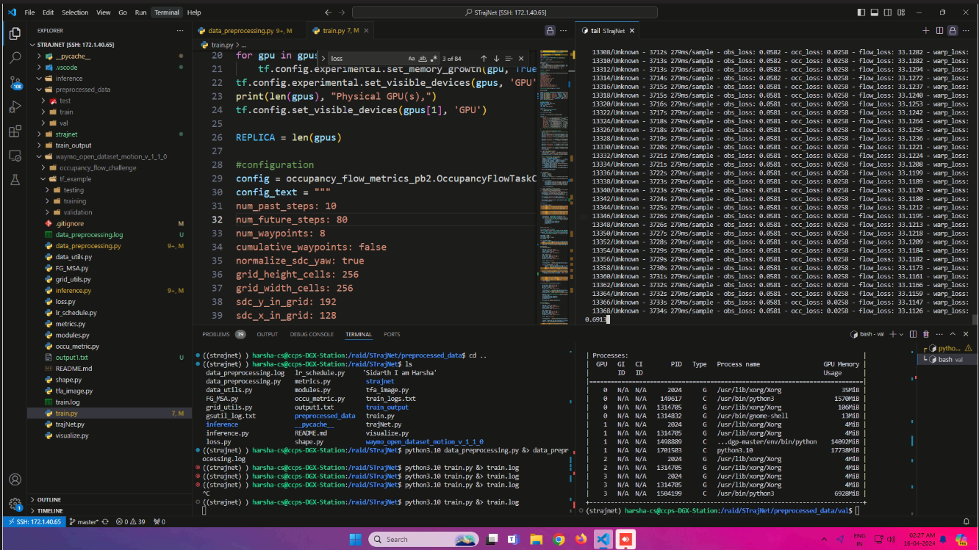

Slide 14
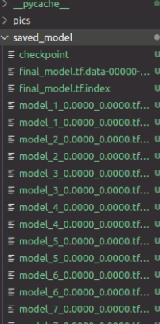
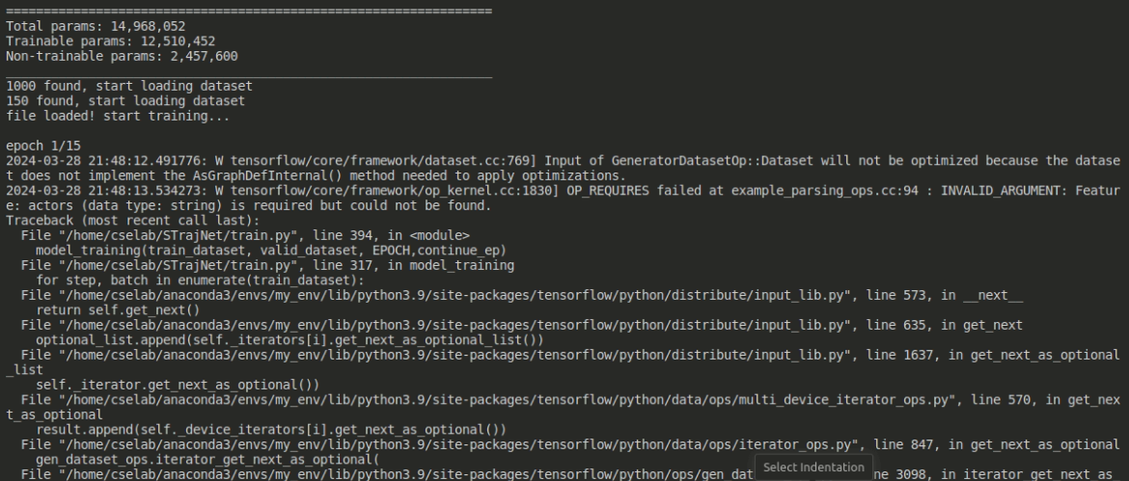

Slide 15
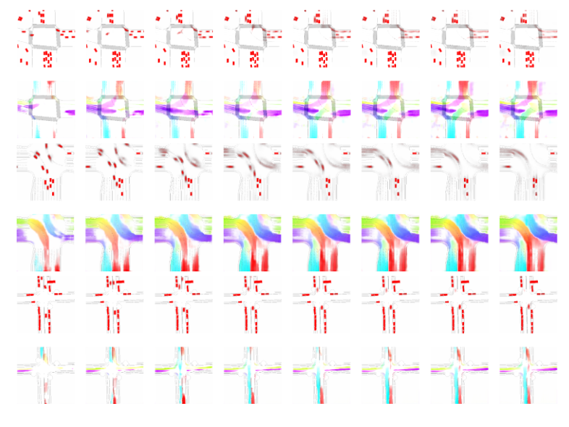

Slide 16
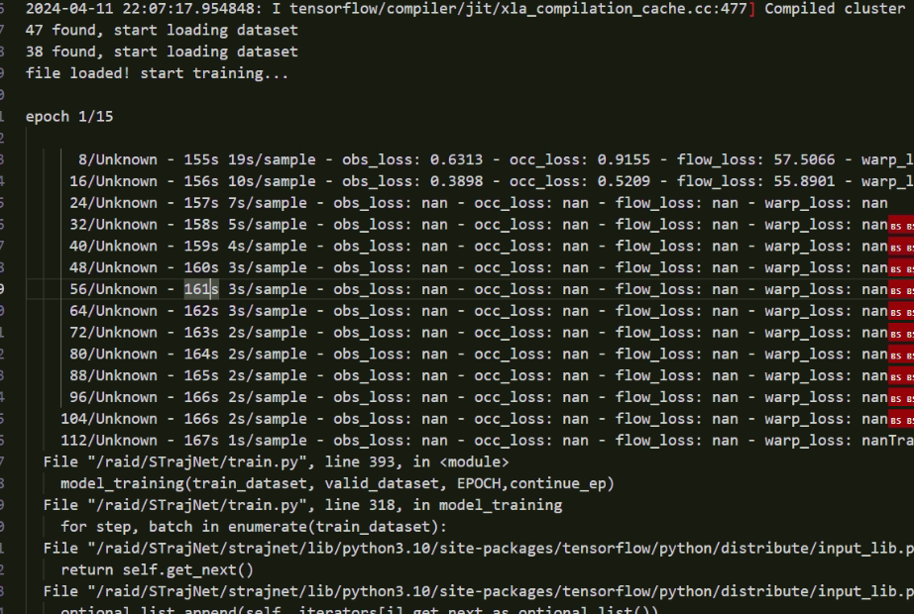

Slide 17
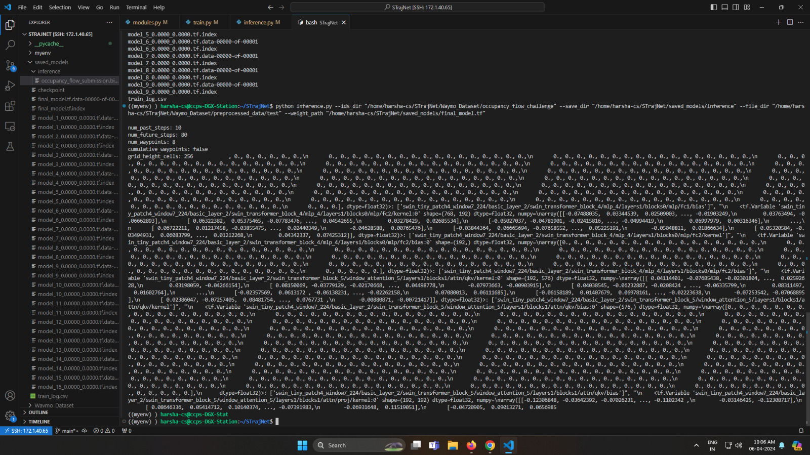

Slide 18
Further Plan to Complete Project
Final Probable Deliverables :
1. Enhanced STrajNet Architecture Documentation:
A comprehensive document detailing the modifications and integrations made to the STrajNet model, including the introduction of GRU layers for temporal prediction.
Architectural diagrams that illustrate the flow and integration of new components within the existing system.
Updated Training and Evaluation Codebase:
A fully updated codebase that includes all modifications made to the model, data preprocessing scripts, model training, and evaluation routines.
Clear instructions on how to set up and execute the updated codebase, ensuring reproducibility of the results.
3. Benchmarking and Performance Evaluation Report:
A detailed report comparing the updated STrajNet model's performance with the original model and current SOTA models across standard KPIs.
An analysis of the model's performance in various scenarios, highlighting the impact of the GRU integration on temporal prediction accuracy.
A report documenting the techniques applied to optimize the model for real-world deployment, with a focus on computational efficiency and inference speed.
Benchmark results showing the optimized model's performance in terms of inference time and resource utilization.
4. Codebase for Evaluation Metrics and Visualization:
Tools or scripts included in the codebase for evaluating the model using predefined metrics relevant to occupancy flow prediction.
Visualization tools that allow for qualitative assessment of the model's predictions, aiding in better understanding and debugging of the model's outputs.

Slide 19
Thank you

